Slide 1
Home Credit Default risk
executive presentation
Tri Nguyen
May 15, 2020
Notes:
Good morning
Today, I would like to present the out come of our analysis in Home Credit default project.
I will start with a summary of the issues, engagement with credit policy team, explaination key findings… next steps

Slide 2
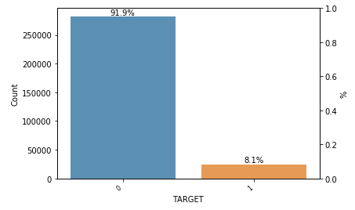
Credit default 8%, ~2% over market average. How to reduce to market average?
Source: Application_test.csv
Impact of high default rates:
5% increase repossession cost in the last 24 months
Miss opportunities on credit-worthy customers
Notes:
First, let’s look at why we are here.
Our credit default rate is at 8%, 2% over market average

Slide 3
Aligned strategy between data analytics and credit policy teams
Briefed with technical team and Chief Data Analyst
May 10
Aligned action plan with Credit Policy team
May 12
Aligned Strategy
Analyzed data
Mar - May
Notes:
We analyzed the credit data from Mar – May… We presented the finding to the technical team on May 10… We came up with aligned strategy with credit policy team for the next steps, which will be presented today

Slide 4
CHANGEs that ARE COMING…
Notes:
. This presented an opportunity to explore low-risk segment and how to be more prudent in term of choosing our current group of customers.
In short, our recommendations are below… I will walk you through the supporting findings that helped us come up with these recommendations

Slide 5
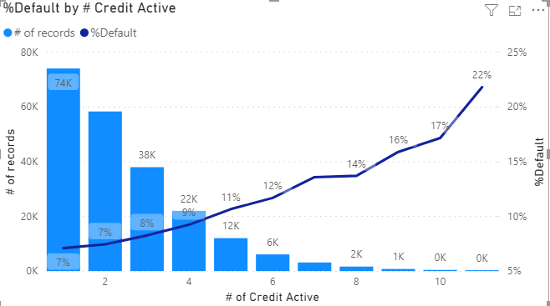
criteria giving loans to customers with high # of active credits will be tightened
Source: Application_test.csv, Bureau.csv
Tighten the policy for customers with >2 active credits.
Notes:
This chart shows the relation between credit default risk with number of active credits. The line shows % default in each category and the bars show the number of records in our samples.
If we give loans to people with <4 active credits, we can maintain the current default rate. To improve, focus on less than 3 active credit segments.
Question is “Does it matter what type of active credit?” We can see in the next few slides.

Slide 6
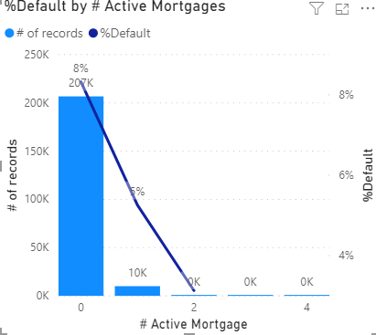
criteria giving loans to customers with active mortgages will be loosened
Source: Application_test.csv, Bureau.csv
Customers with active mortgages have default rate less than market average. Safe segment!
Notes:
That’s mortgage. Higher number of active mortgage, the lower chance of having difficulties in payments.
We also observe a low number of customers with low # of mortgage… This can be a the nature of the market. However, worth Marketing looking into. People with 1 active mortgage have only 5 % chance of default.

Slide 7
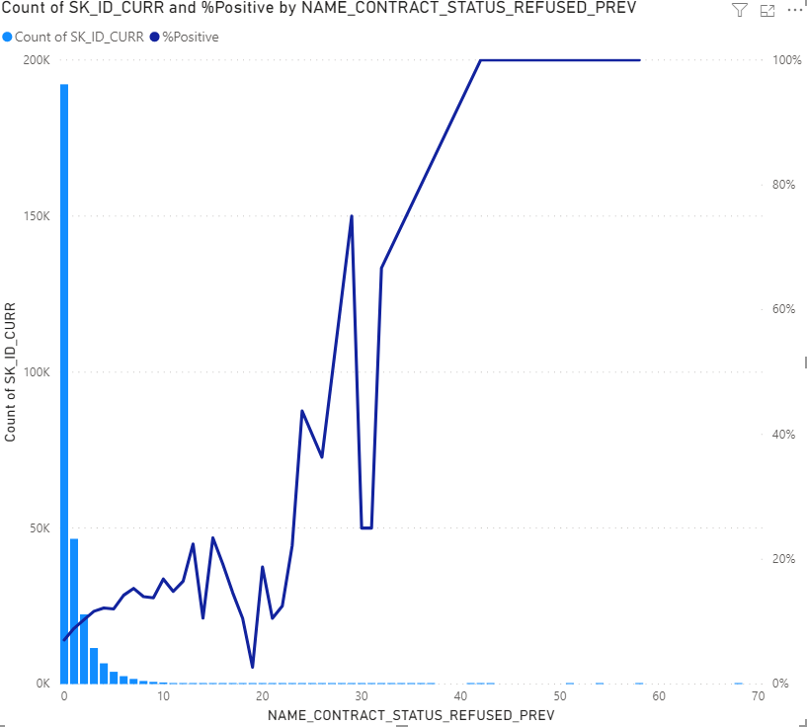
Credit policy team will tighten criteria to approve pre-rejected applicants
% Default by # of Previously Refused applications
Source:
Application_test.csv
Previous_application.csv
# of Previously Refused applications
Notes:
Last, only 0-previously-rejected applications have below 7% default rate. This recommends stricter measures/criteria applied for applicants with higher # of previously rejected applications.

Slide 8
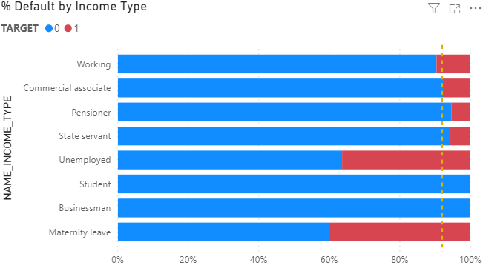
temporary inactive incomes will need to meet certain threshold…
Students and Businessman have low default rate
Source: Application_test.csv
Unemployed and Maternity leave have higher default rate
* Income type cannot be the only factor to deny loan applications
Notes:
Our first recommendation is to tighten the policy to give loans to temporary inactive incomes… Making the income requirement higher for getting a loan. Why…
Unemployed and maternity leave have significantly higher risk of default. While student and businessman have much lower risk. This is also an opportunity to expand our marketing strategy to touch lower risk segment.

Slide 9
The road ahead…
Relook at customers’ active credit count
Target customers with at least ONE active mortgage
Refine the policy to give loans to previously rejected applications
Refine income requirements for loan applications
Credit policy
Data Analytics
Fine tune credit default prediction model
Deploy prediction model
Notes:
First, let’s look at why we are here.
Our credit default rate is at 8%, 2% over market average. This presented an opportunity to explore low-risk segment and how to be more prudent in term of choosing our current group of customers.
In short, our recommendations are below… I will walk you through the supporting findings that helped us come up with these recommendations

